Slide 1
Introductory General Chemistry
Chemistry 3A
S. M. Halloran

Slide 2
The Mole: Avogadro’s Number
Moles and Atoms: Conversions
Molar Mass
Moles and Mass: Conversions
Mass and Particle Number
Percent Composition
Empirical Formulas
Percent of Water in a Hydrate
Molecular Formulas

Slide 3
Avogadro’s Number
Counting atoms and molecules and submicroscopic particles one-by-one is impossible task
Italian scientist Amadeo Avogadro devised the mole
Avogadro’s Number is the number of representative particles of a substance equal to 6.022 × 10²³
SI unit for amount of a substance
The official symbol for Avogadro’s Number is N_{A}

Slide 4
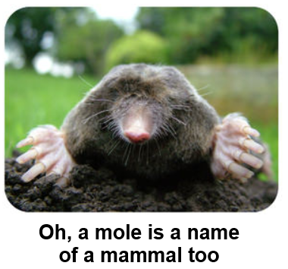
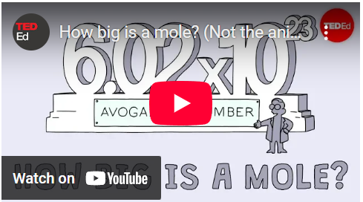
Avogadro’s Number
The number is of a count of particles making up 1 mole (1 mol)
Your online book includes YouTube link on mole concept
Substance | Representative Particle
Most elements, particularly metals | Atom
Diatomic elements: (H₂, O₂, N₂, F₂, Cl₂, Br₂, I₂) Many molecular compounds: H₂O, CO₂ | Molecule
Ionic Compounds: NaCl, Ca(NO₃)₂ | Formula Unit

Slide 5
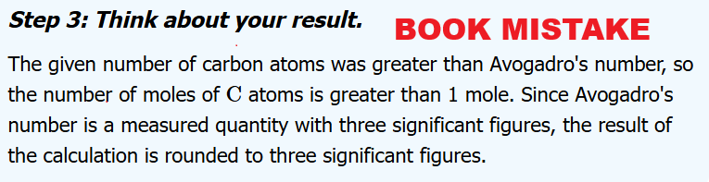

Moles to/from Atoms/Molecules/Particles
Fun with conversions
1 mole = 6.022 x 10²³ particles/atoms/molecules
Official abbreviation for mole is mol
How many moles in 4.72 × 10²⁴ atoms C?
$$4.72 ×{10}^{24} \text{atoms} \text{C} ×\frac{1 \text{mol} \text{C}}{6.022 ×{10}^{23} \text{atoms} \text{C}}=7.84 \text{mol} \text{C}$$
Avogadro’s Number is a defined CONSTANT, not a measured quantity. It is precise to 6.02214076×10²³

Slide 6

Moles to/from Atoms/Molecules/Particles
How many atoms of H (hydrogen) are in 1 mol H₂O?
$$1 \text{mol} {\text{H}}_{\text{2}}\text{O} ×\frac{6.022 ×{10}^{23} \text{molecules}{ \text{H}}_{\text{2}}\text{O}}{1 \text{mol} {\text{H}}_{\text{2}}\text{O}}×\frac{2 \text{atoms} \text{H}}{\text{1 }\text{molecule}{ \text{H}}_{\text{2}}\text{O}}$$
$$=6.022 ×{10}^{23} \text{atoms} \text{H}$$
One conversion factor makes use of Avogadro’s number. The 2nd relates to how many atoms are in a particular molecule

Slide 7

Another Conversion Example
An amount of sulfuric acid (H₂SO₄) containing 4.89 × 10²⁵ oxygen (O) atoms is obtained. How many moles sulfuric acid are there?
$$4.89×{10}^{25} \text{atoms} \text{O}×\frac{1 \text{molecule}{ \text{H}}_{\text{2}}{\text{SO}}_{4}}{4 \text{atoms} \text{O}}×\frac{1 \text{mol}{ \text{H}}_{\text{2}}{\text{SO}}_{4}}{6.022 ×{10}^{23} \text{molecule}\text{s}{ \text{H}}_{\text{2}}{\text{SO}}_{4}}$$
$$=20.3 \text{mol}{ \text{H}}_{\text{2}}{\text{SO}}_{4}$$
Like the previous problem, Avogadro’s number was used along with look at one atom that is part of a molecule.

Slide 8
Molar Mass
The term molar mass refers the mass (in grams) of one mole of a substance.
The units are (usually) grams per mole
Whenever the term mass is used, it will refer to a quantity whose units will be in grams (or a power of 10 in grams: kilograms [kg], milligrams [mg], micrograms [µg], etc). A molar mass will be grams per mole.
The substance can be atoms (pure element), molecules, or particles
Note the old terms atomic weight (for pure elements and molecular weight for molecules and compounds are deprecated

Slide 9
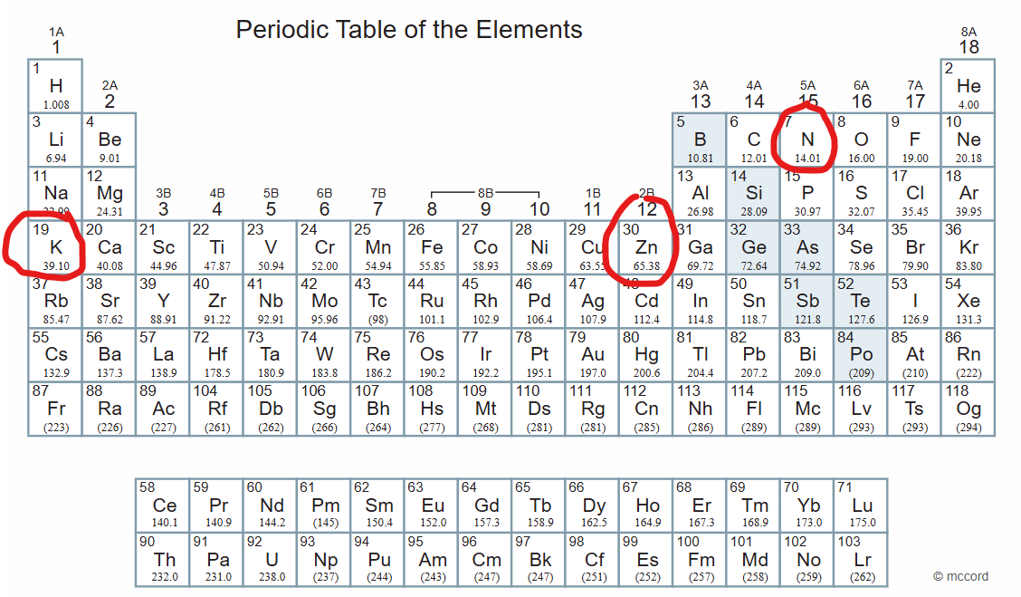
Determining Molar Mass
For atoms of the pure elements, the molar mass is on the Periodic Table
Nitrogen (N): 14.01 grams per mole (g/mol)
Zinc (Zn): 65.38 g/mol
Potassium (K): 39.10 g/mol

Slide 10
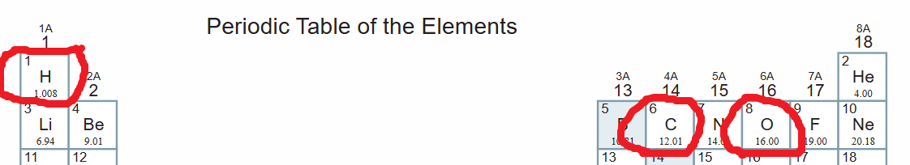

Determining Molar Mass
For compounds/molecules the total mass is computed (by addition) of the component elements taken from the Periodic Table:
H₂O (water): $\left(\frac{\text{2 }\text{mol} \text{H}}{\text{1 }\text{mol} {\text{H}}_{\text{2}}\text{O}}\text{×}\frac{\text{1.008 }\text{g} \text{H} }{\text{1 }\text{mol} \text{H}}\right)\text{+}\left(\frac{\text{1} \text{mol} \text{O}}{\text{1 }\text{mol} {\text{H}}_{\text{2}}\text{O}}\text{×}\frac{\text{16.00 }\text{g} \text{O} }{\text{1 }\text{mol} \text{O}}\right)=18.016 g/mol$
CO₂ (carbon dioxide): $\left(\frac{\text{1} \text{mol} \text{C}}{\text{1 }\text{mol} {\text{CO}}_{\text{2}}}\text{×}\frac{\text{12.01} \text{g} \text{C} }{\text{1 }\text{mol} \text{C}}\right)\text{+}\left(\frac{\text{2} \text{mol} \text{O}}{\text{1 }\text{mol} {\text{CO}}_{\text{2}}}\text{×}\frac{\text{16.00 }\text{g} \text{O} }{\text{1 }\text{mol} \text{O}}\right)=44.01 g/mol$

Slide 11

Computing Molar Mass
You don’t really have to set up the expression the way it was shown. The other way is the long form to show how all units:
H₂O: $2 × 1.008\frac{g}{mol}H+16.00\frac{g}{mol}O=18.016\frac{g}{mol}{\text{H}}_{2}\text{O}$
CO₂: $12.01\frac{g}{mol}C+2 ×16.00\frac{\text{g}}{\text{mol}}\text{O}=44.01\frac{\text{g}}{\text{mol}}{\text{CO}}_{2}$

Slide 12
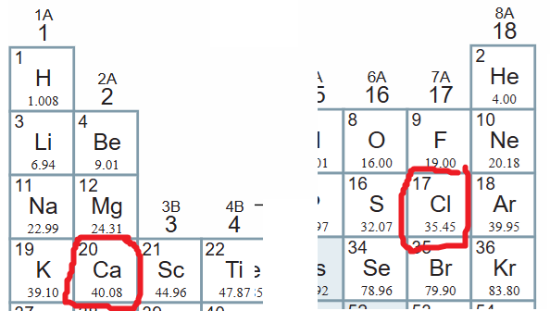

Moles ↔ Mass
Learning by example
3.00 mol calcium chloride (CaCl₂) is needed for experiment
Its computed molar mass =
$$\left(1 ×\frac{40.08 g}{mol}Ca\right)+\left(2 ×\frac{35.45 g}{mol}Cl\right)=\frac{110.98 g}{mol}{\text{CaCl}}_{2}$$
Needed amount: $3 mol{ \text{CaCl}}_{2}×\frac{110.98 g}{mol}{\text{CaCl}}_{2}=333 \text{g}{ \text{CaCl}}_{2}$

Slide 13
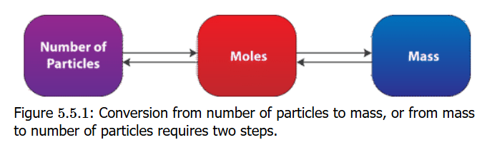

Moles ↔ Mass
Your book correctly points out that converting from particle counts to the observable mass of these particles will involve a two-step conversion
But this is not routine in chemistry or for chemists. It will only be an exercise to demonstrate you understand the concept
How many molecules in 20.0 g chlorine (Cl₂) gas?
$$20.0 g {\text{Cl}}_{2}×\frac{\text{1 }\text{mol} {\text{Cl}}_{2}}{\text{70.90 }\text{g} {\text{Cl}}_{2}}×\frac{6.022 ×{10}^{23} \text{molecules} {\text{Cl}}_{2}}{1 mol {\text{Cl}}_{2}}=1.70 ×{10}^{23} \text{molecules} {\text{Cl}}_{2}$$

Slide 14
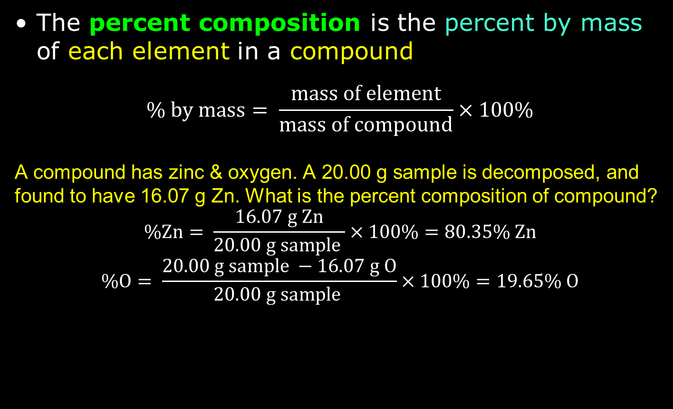
Percent Composition
The percent composition is the percent by mass of each element in a compound
$$\% by mass= \frac{mass of element}{mass of compound}×100\%$$
A compound has zinc & oxygen. A 20.00 g sample is decomposed, and found to have 16.07 g Zn. What is the percent composition of compound?
$$\text{\%}\text{Zn}= \frac{\text{16.07 }\text{g} \text{Zn}}{\text{20.00 }\text{g} \text{sample} }×100\%=80.35\text{\% }\text{Zn}$$
$$\text{\%}\text{O}= \frac{20.00 g sample −\text{16.07 }\text{g} \text{O}}{\text{20.00 }\text{g} \text{sample} }×100\%=19.65\text{\% }\text{O}$$

Slide 15

% Composition from Formula
Dichlorine heptoxide (Cl₂O₇) is a very reactive compound used in organic synthesis
What is the percent composition of Cl₂O₇?
$$\text{\%}\text{Cl}= \frac{\text{2 }\text{mol} \text{C}l × \frac{35.45 g Cl}{1 mol Cl}}{\left(\text{2 }\text{mol} \text{C}l × \frac{35.45 g Cl}{1 mol Cl}+\text{7} \text{mol} O × \frac{16.00 g O}{1 mol O}\right)}×100\%=38.76\text{\% }\text{Cl}$$
$$\text{\%}\text{O}= \frac{\text{7} \text{mol} \text{C}l × \frac{16.00 g O}{1 mol O}}{\left(\text{2 }\text{mol} \text{C}l × \frac{35.45 g Cl}{1 mol Cl}+\text{7 }\text{mol} O × \frac{16.00 g O}{1 mol O}\right)}×100\%=61\text{.24}\text{\% }\text{O}$$
Since oxygen was the only element of two, it’s also possible to take 100% - 38.76% = 61.24% to get the value

Slide 16

A Formula for Mass of Elements
To get the mass in grams of each element, suppose there are x of the compound Cl₂O₇ in a sample.
To calculate the grams of element Cl and of element O in Cl₂O₇, just use the formulas:
$$mass of sample \left(g\right)×38.76\text{\% }\text{Cl}\text{ = }\text{mass} \text{of} \text{Cl}\text{ (}\text{g}\text{)}$$
$$mass of sample \left(g\right)×61.2\text{4}\text{\% }\text{O}\text{ = }\text{mass} \text{of} \text{O}\text{ (}\text{g}\text{)}$$
Example: a 12.50 g Cl₂O₇ sample has 4.845 g Cl and 7.655 g O

Slide 17
Empirical Formula Determination
Recall that the definition of empirical formula is the lowest integer ratio of the elements in a compound. For instance, glucose has a molecular formula of C₆H₁₂O₆, but its empirical formula is CH₂O
The reason for the empirical formula was because in analyzing a substance, it was the proportions of the elements chemists first saw in the analysis. They did not immediately have an understanding of how many atoms of each element actually made up a molecule or formula unit
The process of getting the empirical formula is called elemental analysis

Slide 18
Elemental Analysis
Get exactly 100 g of the compound: enables the grams of a component element to also be the percentage of the component element
Determine from the mass in grams of a component element to moles of it using molar mass
Find the component element with the fewest (smallest number) moles of the compound, and use that number to divide the mole values of all other elements; the element with fewest moles should be 1
Step 3 should hopefully produce (almost) integer values in all other elements: those integers become the subscripts of the elements in the formula
In some cases, step 3 may be produce integer values: multiply each of moles by smallest whole number to convert each into whole number. Write formula

Slide 19

Elemental Analysis: Example
A compound is composed of 69.94% iron (Fe) and 30.06% oxygen (O). What is the empirical formula?
A 100 g sample should b 69.94 g Fe and 30.06 g O
Convert to moles each element
$$69.94 g Fe ×\frac{1 mol Fe}{55.85 g Fe}=1.252 mol Fe$$
$$30.06 g O ×\frac{1 mol O}{16.00 g O}=1.879 mol O$$
Divide all values by the smallest (mole) value:
$\frac{1.252 mol Fe}{1.252}=1 mol Fe$ $\frac{1..879 mol O}{1.252}=1.501 mol O$
Try to make all values a whole number. Multiplying by 2 will achieve this:
$1 mol Fe ×2=2 mol Fe$ $1.501 mol O×2=3 mol O$
Formula: Fe₂O₃

Slide 20
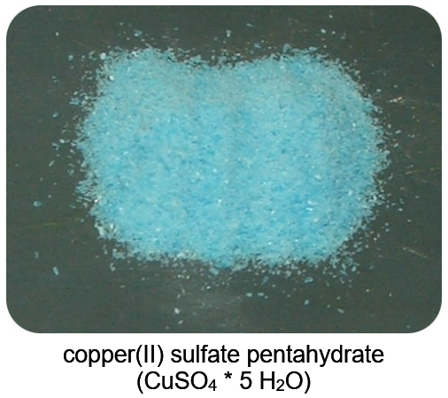
Bluish-Green vs White Copper Sulfate
Copper(II) sulfate is a typical ionic compound which is white in color as a solid
But when hydrated, H₂O molecules coordinate around the copper atom through the orbitals of its d electrons, and this coordinate bonding creates a bluish-green color for the compound
Water molecules actually coordinate with formula units of many ionic compounds. Metal atoms in anhydrous form are often colored, but this bonding to H₂O molecules can cause a different color

Slide 21
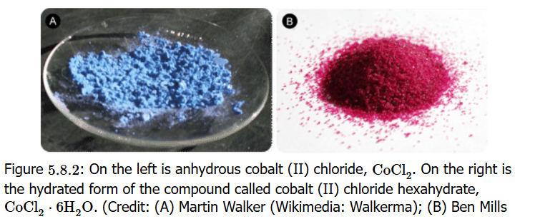
Other Hydrates: Cobalt(II) Chloride
Useful to know the percent water in a hydrate
What is the % hydrate of cobalt(II) chloride hexahydrate (CoCl₂ • 6 H₂O)?

Slide 22
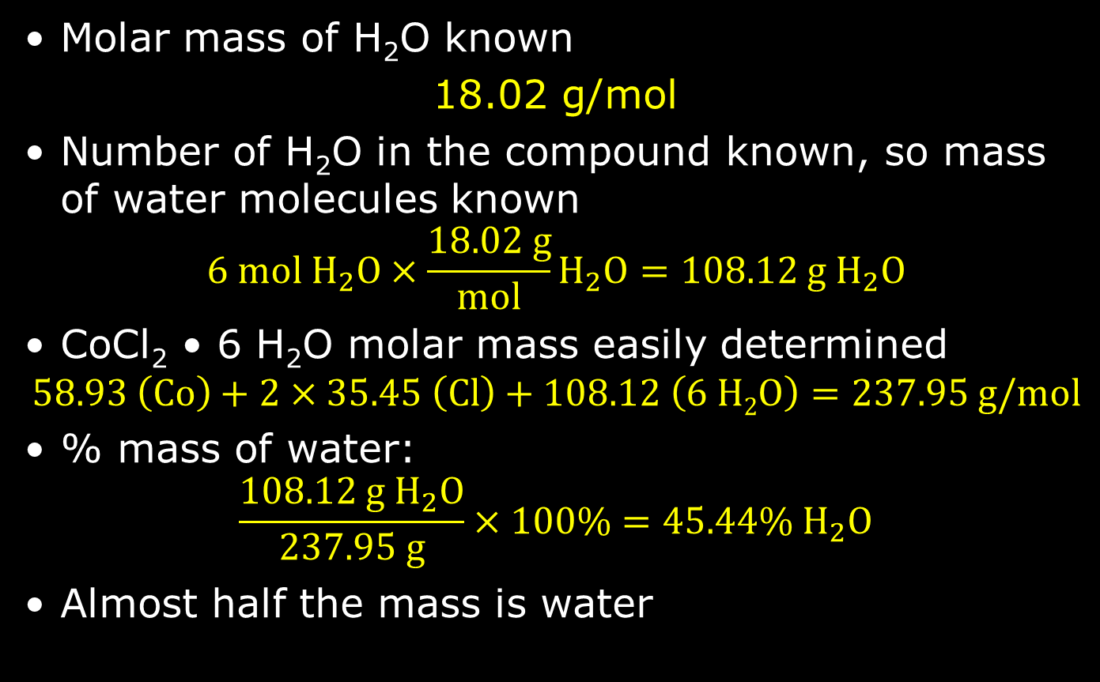
Percent Water in CoCl₂ • 6 H₂O
Molar mass of H₂O known
18.02 g/mol
Number of H₂O in the compound known, so mass of water molecules known
$$6 mol{ H}_{2}O×\frac{18.02 g}{mol}H_{2}O=108.12 g H_{2}O$$
CoCl₂ • 6 H₂O molar mass easily determined
$$58.93 \left(Co\right)+2×35.45 \left(Cl\right)+108.12 \left(6 H2O\right)=237.95 g/mol$$
% mass of water:
$$\frac{108.12 g{ H}_{2}O}{237.95 g}×100\%=45.44\% H_{2}O$$
Almost half the mass is water

Slide 23
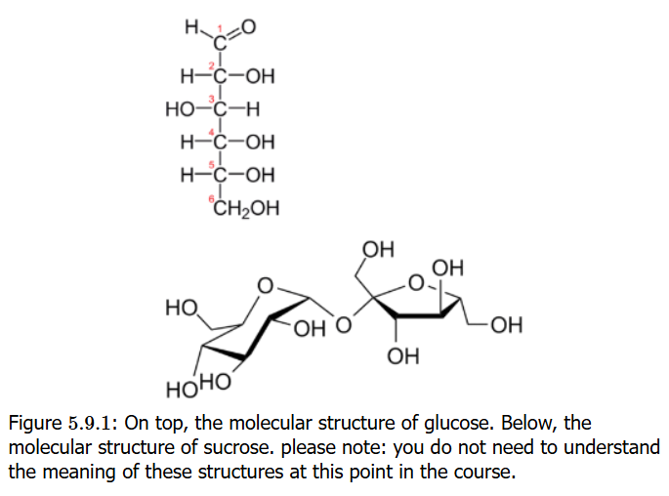
Glucose and Sucrose
Glucose is a monosaccharide (carbohydrate) essential to life, metabolized (“burned”) using oxygen (O₂) to carbon dioxide (CO₂) and water (H₂O)
Sucrose (table sugar) is a disaccharide of glucose and fructose, and fructose is an isomer of glucose easily converted to glucose in metabolism
How does one distinguish between glucose and sucrose?

Slide 24
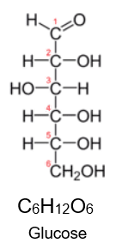
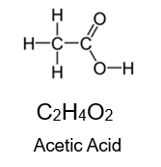
Molecular Formula Determination
Molecular formulas: the info about the kind and the number of atoms of each element present in a molecular compound
The molecular formula and empirical formula can be identical in many cases, e.g. in methane (CH₄)
Acetic acid (main acid in vinegar) and glucose have different molecular formulas but the same empirical formula: CH₂O
Empirical formulas are learned from percent composition elemental analysis
Molecular formulas require knowing molar mass of compound

Slide 25

Empirical ➔ Molecular Formula
Calculate empirical formula mass (EFM): this is molar mass of empirical formula
Determine
${compound molar mass}/{EFM}$ =whole number or close to it
Multiply subscripts in empirical formula by whole number from Step 2 ➔ this is molecular formula

Slide 26


Empirical ➔ Molecular Formula
Let’s apply the process to an example
Empirical formula of compound containing boron and hydrogen is BH₃ which has molar mass of 27.7 g/mol
EFM = 10.81 + 3×1.008 = 13.84 g/mol
$\frac{molar mass}{EFM}=\frac{27.7}{13.84}=2$
BH₃ × 2 = B₂H₆ ⬅ molecular formula

Slide 27
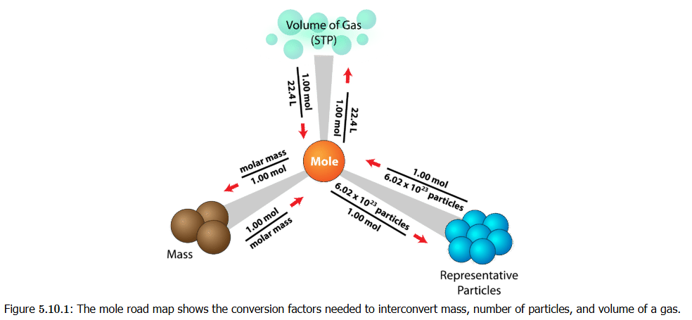
Converting Mass/Moles/Gas Volume
The online book’s Mole Road Map
Interrelates particle count, mass (in grams), and volume of a gas
Latter won’t be important until we get to gases

